Slide 1
Pitch Deck

Slide 2
What is a pitch deck?
A pitch deck is a brief presentation, often created using PowerPoint, Keynote or Prezi, used to provide your audience with a quick overview of your business plan. You will usually use your pitch deck during face-to-face or online meetings with potential investors, customers, partners, and co-founders.

Slide 3
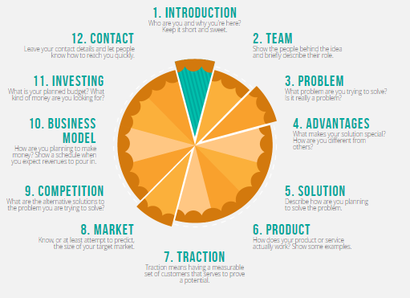
The pitch deck should contain

Slide 4
The Do’s of a pitch deck
Tell a story & engage people emotionally: Everyone loves to hear stories, even the investors. So tell an exciting story about your startup.
Limit each slide to expressing one idea: You want to keep your entire audience on the same page.
Prepare to make a great first impression: First impressions are powerful. Believe it. The first 2-3 minutes are the most important.
Show the people behind your idea: Focus on a significant, relevant accomplishment for each person in a team that identifies that person as a winner.
Keep a consistent look in presentation: Use the same font, size, color and capitalization format across all slides of your investment pitch deck.
Know your metrics better than anyone: Traction speaks louder than words.

Slide 5
The Dont’s of a pitch deck
Don't use too many bullet Points: Limit the bullets. Too many bullet points will kill a presentation.
Don't make it too long: Average entrepreneur pitch: 38 slides. Average VC attention span/cranial capacity: 10 slides. Do the math
Don't read word by word from your script; You will sound like a robot and miss the all-important eye contact with the audience.
Don't create a text-rich, picture-poor presentation: People cannot read and listen at the same time. Great visual inspire and engage people emotionally.
Don't come unprepared: Try to anticipate the kinds of questions they might have and be prepared with answers.
Don't use small fonts: Always use a font large enough to be seen by all audience members. Use 32- to 44-point for titles and no smaller than 28-point for the text or bulleted items.

Slide 6
Other slides you might include in your pitch presentation
Exit strategy
Partnerships
Demo and screenshots
Other documentation:
Executive summary
Technical documentation
Detailed financial models
Detailed market research

